Slide 1
Parallel Algorithms for Sorting

Slide 2
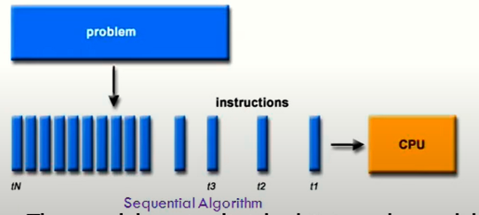
Algorithms
An algorithm is a sequence of steps followed to solve a problem. It take input from the user and after some computation, produces an output.
Depending on the architecture of computer, we have two types of algorithms:
Sequential algorithm- an algorithm in which some consecutive steps of instructions are executed in a chronological order to solve a problem.

Slide 3
Parallel Algorithm- The Problem is divided into sub-problems and are executed in parallel to get individual outputs. Later on, these individual outputs are combined together to get the final desired output.
To be run on parallel machines or parallel computers
It can be executed simultaneously on many different processing devices and then combined together to get the correct result.
Parallel algorithms are highly useful in processing huge volumes of data in quick time.

Slide 4
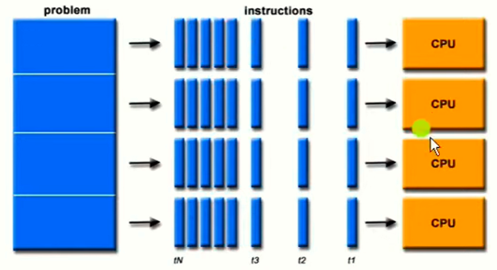

Slide 5
Principle of parallel Algorithm Design
The first step in developing a parallel algorithm is to decompose the problem into tasks that can be executed concurrently
A given problem may be decomposed into tasks in many different ways.
Tasks may be of same, different or even indeterminate sizes.
A decomposition can be shown in the form of a directed graph with nodes corresponding to tasks and edges indicating that the result of one task is required for processing the next. Such a graph is called a task dependency graph.

Slide 6
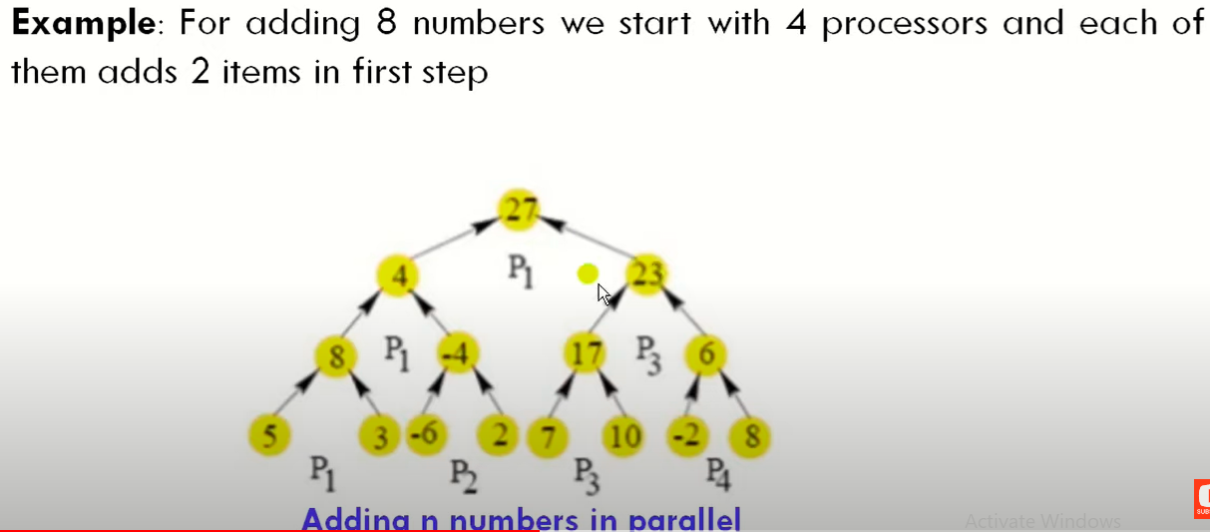

Slide 7
Approaches to develop parallel algorithm
Parallel algorithm for a given problem may be developed using one or more of the following:
Detect and exploit the inherent parallelism available in the existing sequential algorithm.
Independently invent a new parallel algorithm
Adapt an existing parallel algorithm that solve a similar problem

Slide 8
Parallel Algorithm Complexity
A parallel algorithm is analyzed mainly in terms of its time, processor and work complexities.
Time complexity T(n): execution time/run time
How many time steps are needed?
Processor Complexity p(n): total number of processors used
Work complexity w(n): total Cost
Total cost= time complexity * number of processors used.

Slide 9
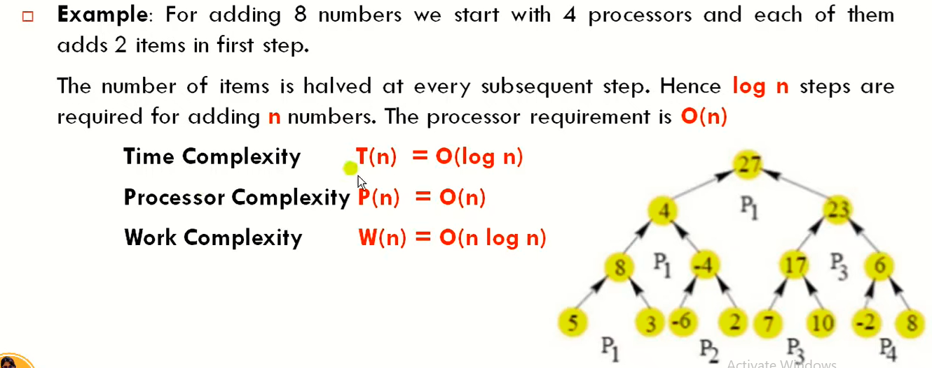

Slide 10
Parallel Sorting Algorithms
Parallel Bubble Sort
Parallel Merge Sort
Bitonic Sort
Shear sort

Slide 11
Bubble Sort
One of the straight- forward sorting methods
Cycle through the list
Compares consecutive elements and swaps them if necessary
Stops when no more out of order pair
Slow and effiecient
Average performance is O(n^2)

Slide 12
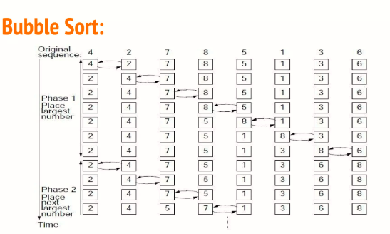

Slide 13
Parallel Bubble sort
Also knows as odd- even bubble sort
Operates in two alternate phases:
Phase even:
Even processes exchange values with right neighbors
Odd processes exchange values with right neighbors.

Slide 14
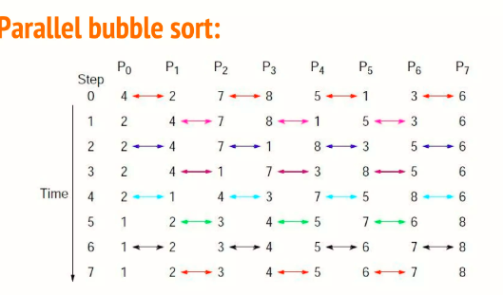

Slide 15
Merge Sort
Divide and Conquer algorithm
Sorting method to sort a vector; first divide it in two parts
Applies again the same method to each part and when they are both sorted with m and n elements
They are merged to produce a sorted vector that contains m+n elements of the initial vector
The average complexity is O(nlogn)

Slide 16
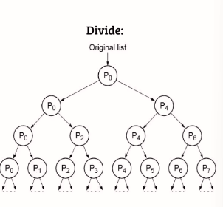
Parallel Merge Sort
Collects sorted list onto one processor
Merge elements as they come together
Simply tree structure
Parallelism is limited when near the root

Slide 17
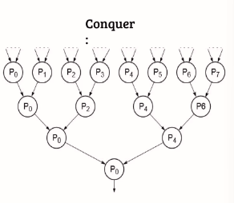
Collects sorted list onto one processor
Merge elements as they come together
Simple tree structure
Parallelism is limited when near the root

Slide 18
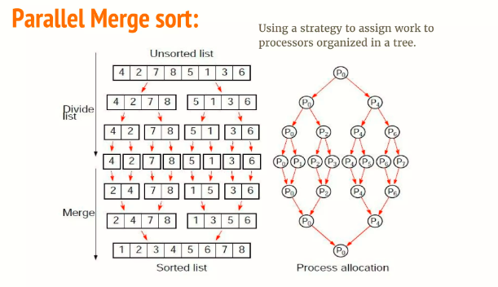

Slide 19
Odd-even merge is a merging algorithm for sorted lists which can merge two sorted lists into one sorted list. It works as follows:
Let A = [a0, . . . , an−1] and B = [b0, . . . , bn−1] be two sorted lists
Consider E(A) = [a0, a2, . . . , an−2], E(B) = [b0, b2, . . . , bn−2] and O(A) = [a1, a3, . . . , an−1], O(B) = [b1, b3, . . . , bn−1] as the sublists with the elements of A and B in even and odd positions, respectively
Recursively merge E(A) with E(B) to obtain C
Recursively merge O(A) with O(B) to obtain D
Interleave C with D to get an almost-sorted list E
Rearrange unordered neighbors (using compare-and-exchange operations) to completely sort E

Slide 20
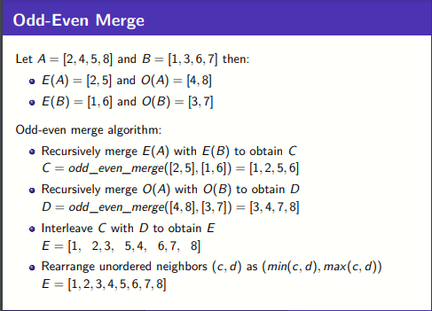

Slide 21
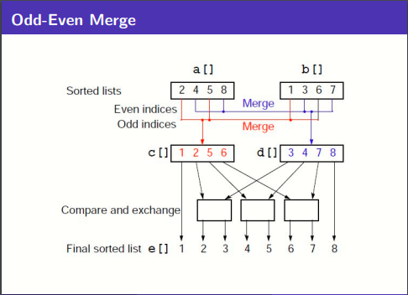

Slide 22
Quicksort is a popular sorting algorithm also using a divide-and-conquer approach. The initial unsorted list is first divided into two sublists in such a way that all elements in the first sublist are smaller than all the elements in the second sublist. This is achieved by selecting one element, called a pivot, against which every other element is compared (the pivot could be any element in the list, but often the first or last elements are chosen). Each sublist is then applied the same division method until individual elements are obtained. With proper ordering of the sublists, the final sorted list is then obtained.
On average, the quicksort algorithm shows a time complexity of O(n log(n)) and, in the worst case, it shows a time complexity of O(n²), though this behavior is rare.

Slide 23
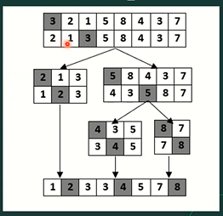

Slide 24
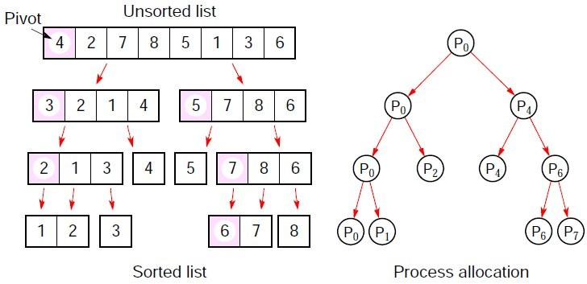
As for mergesort, the idea is to take advantage of the tree structure of the algorithm to assign work to processes.

Slide 25
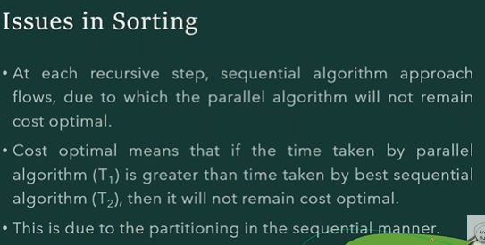

Slide 26
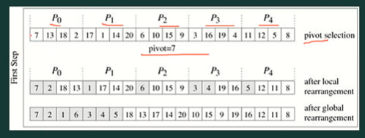

Slide 27
Bitonic Mergesort
The basis of bitonic mergesort is the bitonic sequence, a list having specific properties that are exploited by the sorting algorithm.
A sequence is considered bitonic if it contains two sequences, one increasing and one decreasing, such that:
a₁ < a₂ < . . . < a_{i −1} < a_{i} > a_{i +1} > a_{i +2} > . . . > a_{n}
for some value i (0 ≤ i ≤ n). A sequence is also considered bitonic if the property is attained by shifting the numbers cyclically (left or right).

Slide 28
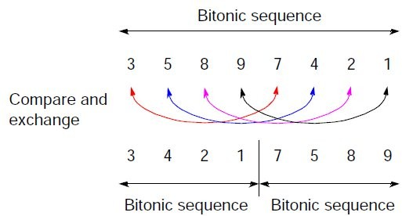
A special characteristic of bitonic sequences is that if we perform a compare-and-exchange operation with elements a_{i} and a_{i +n/2} for all i
(0 ≤ i ≤ n/2) in a sequence of size n, we obtain two bitonic sequences in which all the values in one sequence are smaller than the values of the other.

Slide 29
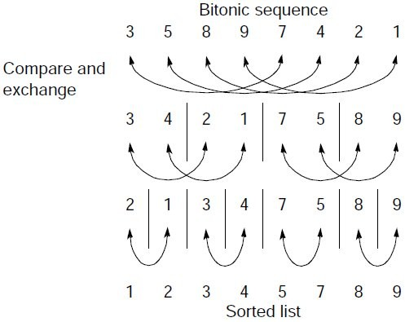
In addition to both sequences being bitonic sequences, all values in the left sequence are less than all the values in the right sequence.
Hence, if we apply recursively these compare-and-exchange operations to a given bitonic sequence, we will get a sorted sequence.

Slide 30
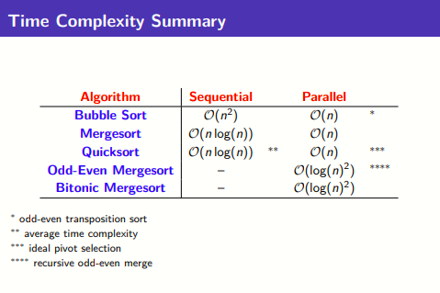

Slide 31
Sample Questions
1. Describe the three different hardware architectures for parallel database systems.
2. Why is a shared-nothing architecture attractive for parallel database systems?
3. Explain the software architecture for execution of individual operation in parallel.
4. Explain the difference between pipelined parallelism and data-partitioned parallelism.
5. How you would implement the SQL statement ‘select * from employee order by salary’ in a parallel database system?
6. Describe the software architecture for parallel sorting.
7. Explain how two tables can be joined to exploit parallelism.
8. Describe different data partitioning techniques mentioning there advantages and disadvantages.
9. Distinguish between intra operator parallelism and inter operator parallelism.

